Slide 1
Dopamine Medication
Mechanism of action
Dosing
Side effects
Contraindications
Nursing interventions
Patient teaching
Evolution
Desired outcome
Nursing diagnosis

Slide 2
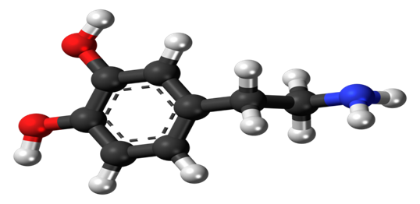
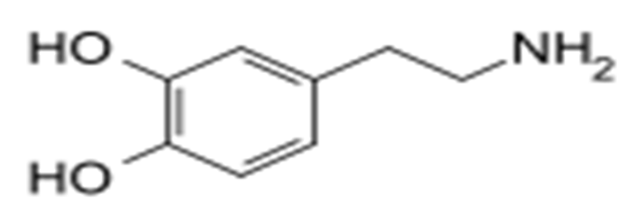
Mechanism of action
Dopamine Structure
Dopamine is the extrapyramidal system key transmitter in the brain, and vital in controlling blood flow within the body.
Dopamine medication is an generic element of the catecholamine and phenethylamine class that introduces a catecholamine neurotransmitter into the neurons of both the central and peripheral nervous systems ("Dopamine- mechanisms of action | Australian Prescriber," ).
Even though dopamine is produced naturally in the body, its medication introduces inotropic agent that assists in the increment of blood flow into body organs thus treating conditions that occur to a person in shock that is as a result of trauma, cardiac attack, kidney and heart failures, and other severe health situations.

Slide 3
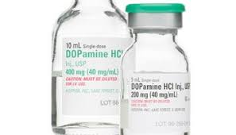
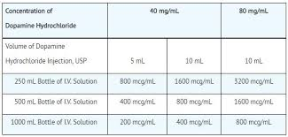
2. Dosing
The medication should be administered under specialists directives and its ideal to notify them of any allergies, prescription and over-the-counter medications you use, as well as other medical conditions (Marinosci, Robertis, & Piazza, 2012,)
Mostly, dopamine is given by intravenous infusion in ("Dopamine Injection: Uses, Dosage & Side Effects - Drugs.com," ):
  Low dosages of: 1 to 5 mcg/kg/minute IV to raise urine output and kidney blood flow.
  Medium dosages of: 5 to 15 mcg/kg/minute IV to improve kidney blood flow, cardiac output and contractility, and heart rate.
  High dosages of : 20 to 50 mcg/kg/minute IV to increase blood pressure and stimulate vasoconstriction;

Slide 4

3. Side Effects
Some major and minor side effects of having a dopamine injection include (Ford & Roach, 2013):
  Chest pains.
  Changes in heartbeats.
  Painful, bloody or difficult urination.
  Shallow or weak breathing.
Side effects that are signs of allergic reactions and need emmediate medical care comprise of ("Dopamine Injection: Uses, Dosage & Side Effects - Drugs.com,"):
  Rashes.
  Difficulty in inhaling and exhaling.
  Facial swellings
  Tongue or lips swelling.

Slide 5

4. Contraindications
The reason for administering dopamine under a doctor’s instructions as well as disclosing any type medical conditions or allergies is to avoid using it on patients with pheochromocytoma and in the presence of uncorrected ventricular fibrillation or tachyarrhythmias.
There are various conditions contraindicated with the drug. Its therefore ideal for a patient to check with a physician for the following conditions and allergies (Ford & Roach, 2013, ):
  Acidosis
  Heart Ventricle Rhythm Problem
  Blockage or Closing Off of Blood Vessels
  decreased oxygen in the tissues or blood
  Decreased Blood Volume
  Sympathomimetic Agents

Slide 6

5. Nursing interventions
Monitor patients’ cardiac pulse, blood pressure, and exterior beats at intermissions recommended by the doctor as well as ensure precise measurements essential for accurate dosage.
Report any anomalies promptly to the doctor for considerable changes in medication: Anomalies such as low urine flow rates without hypotension; rising tachycardia; dysrhythmias; and uneven increase in diastolic pressure.
Observe therapeutic success of the medication as well as the progress of urine flow, additional indices of sufficient doses and perfusion of vital body parts (Monahan, Neighbors, Green, & Swearingen, 2011)

Slide 7

6. Patient Teaching
Its necessary for medical practitioners to educate their patients on the facts of this medication so they an disclose all their medical histories and conditions before the drug is administered ("Intropin (dopamine) dosing, indications, interactions, adverse effects, and more," 2018).
Given the severity of inducing this drug, patients need to be notified of its side effects, contraindications, various allergic reactions, plus the signs of any significant reaction; from the list of side effects and allergic reactions, let the patient know the reactions that might need a physicians attention and which reactions the patient should not be worried about.

Slide 8
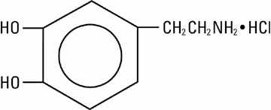
7. Evolution
Dopamine is induced in the patients body via an injection known as Dopamine Hydrochloride Injection (HCI), Which is diluted in an suitable sterilized parenteral solution ahead of the intravenous injection ("Intropin (dopamine) dosing, indications, interactions, adverse effects, and more," 2018).
The drug yields positive chronotropic and inotropic results on the myocardium, leading to faster heart rate and cardiac contractility.
A patient indicates dopamine indication through: Poor perfusion of vital organs; low cardiac output and hypotension ("Intropin (dopamine) dosing, indications, interactions, adverse effects, and more," 2018).

Slide 9
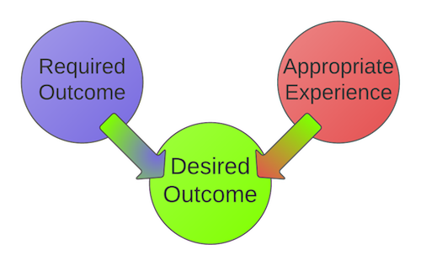
8. Desired outcome
Depending on the dosage, dopamine medication outcomes consist of (Marinosci, Robertis, & Piazza, 2012):
  An upsurge in sodium defecation in the kidneys
  A rise in urine passing.
  An increment in heart beat pace.
  An escalation in blood pressure
When the dosage is low, it acts from one sensitive nerve system to another increasing the cardiac muscle contraction force as well as the heart beat rate, thus accelerating the patient’s blood pressure (Marinosci, Robertis, & Piazza, 2012).
Huge dosages result to vasoconstriction which escalates the blood pressure too.

Slide 10

9. Nursing Diagnosis
Prior to the administration of the dopamine medication, potential nursing diagnosis include:
  Flesh tissue perfusion, ineffective associated with hostile effects of treatment.
  Injury threats to tissue interrelated to extravasation of medicine.
  Gas exchange and breathing weakened connected to insufficient cardiac output (Monahan, Neighbors, Green, & Swearingen, 2011).
After the administration of dopamine, possible diagnosis include: headache; anxiety; nausea; goose bumps, vomiting; and may be chills (Monahan, Neighbors, Green, & Swearingen, 2011).

Slide 11
References
Dopamine Injection: Uses, Dosage & Side Effects - Drugs.com. (n.d.). Retrieved from https://www.drugs.com/dopamine.html
Dopamine- mechanisms of action | Australian Prescriber. (n.d.). Retrieved from https://www.nps.org.au/australian-prescriber/articles/dopamine-mechanisms-of-action
Ford, S. M., & Roach, S. S. (2013). Student workbook for Roach's introductory clinical pharmacology.
Intropin (dopamine) dosing, indications, interactions, adverse effects, and more. (2018, March 11). Retrieved from https://reference.medscape.com/drug/intropin-dopamine-342435
Marinosci, G. Z., Robertis, E. D., & Piazza, O. (2012). Dopamine Use in Intensive Care: Are We Ready to Turn it Down?
Monahan, F. D., Neighbors, M., Green, C. J., & Swearingen, P. L. (2011). Swearingen's manual of medical-surgical nursing: A care planning resource. Maryland Heights, MO: Elsevier Mosby.

